Slide 1
Beating the forecast
What Watts Consulting
Notes:
Firstly
“I would like to show my respects and acknowledge the Dharug people who are the Traditional Custodians of the Land, of Elders past and present for where i am presenting for this virtual meeting.”
In 2020 i was doing a maths paper, with bushfires raging near my house, I remember thinking, “I hope i have sufficient fuel for the generator and fire pumps, this fire is getting close”. I was experiencing an energy supply and demand problem, my energy demand was dependant on the proximity of the fire, my supply was unknown, I was likely to need backup power, terrifying times”
Hi, my names is James and I am with What Watts consulting

Slide 2
OUR COMPANY
Founded in 2021, What Watts Consulting is an Australian-based Data Science consultancy firm, founded on the principle of using unconventional methods to solving big problems.
Notes:
What watts consulting is a data science consultancy, focusing on unconventional methods to solve the big problems, with our personal experience with energy supply and demand problems we were excited to be asked to work with AEMO to find a more accurate forecast. And congratulations Daniel on your new role as CEO of AEMO and welcome back to Australia, we look forward to working with you.
One of the things i think you will like in our capability is our focus on decreasing the impact of outlier events, where the current forecasts miss total demand, putting unforeseen strain on the grid

Slide 3




WHO ARE WE?
James
Nee
Chief Reporting Officer
(Resistor)
Head of Python & Power BI
(Code Capacitor)
Peter
Ruhul
Senior R Consultant
(Surge Protector)
Executive Manager - Modelling
(Frequency Modulator)
Notes:
I am here today with my colleagues, Nee, Peter and Ruhul, we will be walking you through the challenges in the energy forecasting and how we have created a new capability based on data driven analysis
This will help AEMO to provide greater precision and accuracy for a short term forecasting focusing on 6-24 hours in the future. At the end of the session you will see how out capability will enable you to better identify outlier events, and avoid confusion and challenges for your customers, the energy suppliers.

Slide 4
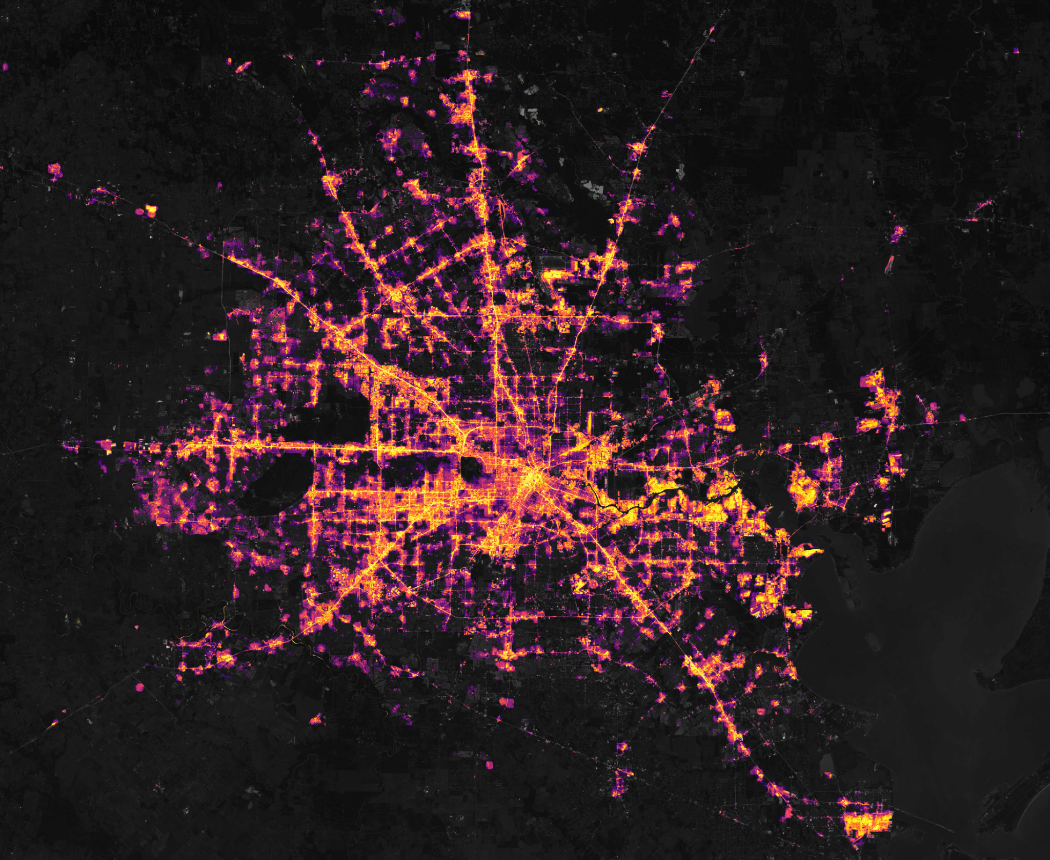
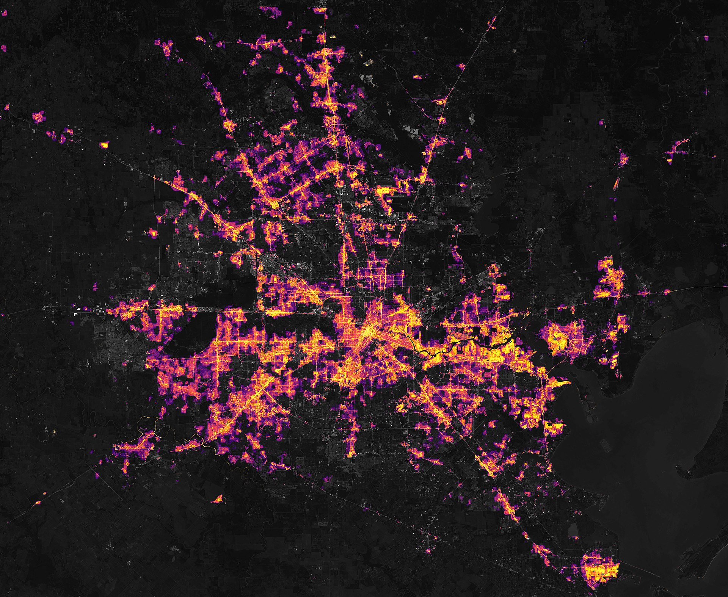
Background
Feb 7 - before event
Feb 16 - after event
Lives Lost | At least 151
Property Damage | US$195.6 billion
Notes:
I thought i would share some background of how significant the power issues can be. Daniel, with your stint working on renewables in the US this won’t come as a surprise, however, in February 2021 extreme weather conditions caused catastrophic failure of the TEXAS power grid, causing at least 150 deaths, and almost 2 billion dollars in properyty damage. This is an issue that we don’t want in Australia. Luckily the AEMO has systems in place to help avoid this, including forecasting and modeling of demand and price, as well as having an integrated grid across all of eastern Australia to ensure that the grid is highly resilient, with each state able to kick in and support each other.

Slide 5

TABLE OF CONTENTS
01
02
03
CHALLENGE & APPROACH
JOURNEY & DISCOVERY
CAPABILITY & RECOMMENDATIONS
Notes:
My colleagues will take you through the challenges, the Discovery , and finally showing the the capability we have developed We will also share with you how together, we can improve and enhance this capability into the future.
Now I will hand to Ruhul, who will take you through the challenges and how we will measure success

Slide 6
01
Challenge & Approach
Notes:
Thank you James.
So what is the Business Challenges

Slide 7




Business Challenge
Energy Supply MUST equal Demand. Discrepancies in Energy Demand forecast causes challenges for Energy Supply.
Rooftop solar data is not included in models. Drives model inaccuracy & Influences outlier days
Extreme temperatures, driving heating & cooling lead to discrepancies between forecasted & true demand.
Abnormal & non-correlated events such as Covid & bushfires
Notes:
· Energy supply must be equal to demand to avoid black-out. The national grid operates at a frequency of 50 Hz. The Grid operators ensure this frequency remains stable 24 hrs a day, 7 days a week. Any imbalance of electricity feed into the grid causes the deviation of this frequency.
· Installation of Rooftop solar increased over the years. The solar energy data is not included in the current AEMO (Australian Energy Market Operator) model which drives inaccuracy and increases outliers.
· Some days there are heatwave or cold wave which lead to significant variance between demand and forecast
· Paranormal events such as Bushfire or Covid lockdown raise inconsistency in the demand and supply
Temperature is a feature engineering
Bottom line is reasons why it isn;t perfect
Scenario: on days when rooftop solar is high, demand might decrease to an amount that the forecast will be significantly less than traditional forecasts show, resulting in an over supply of Electricity with the base systems providing to much power

Slide 8




Technical Objectives
Forecasting models are outdated and need improvements
Outlier Identification
Identify additional features to use
Identify measures of success
Notes:
How to address the Challenges
· To identify outliers (the absolute difference is more than 500 MW)
· Identify additional important features
· Identify measure of success
· Design improved models

Slide 9
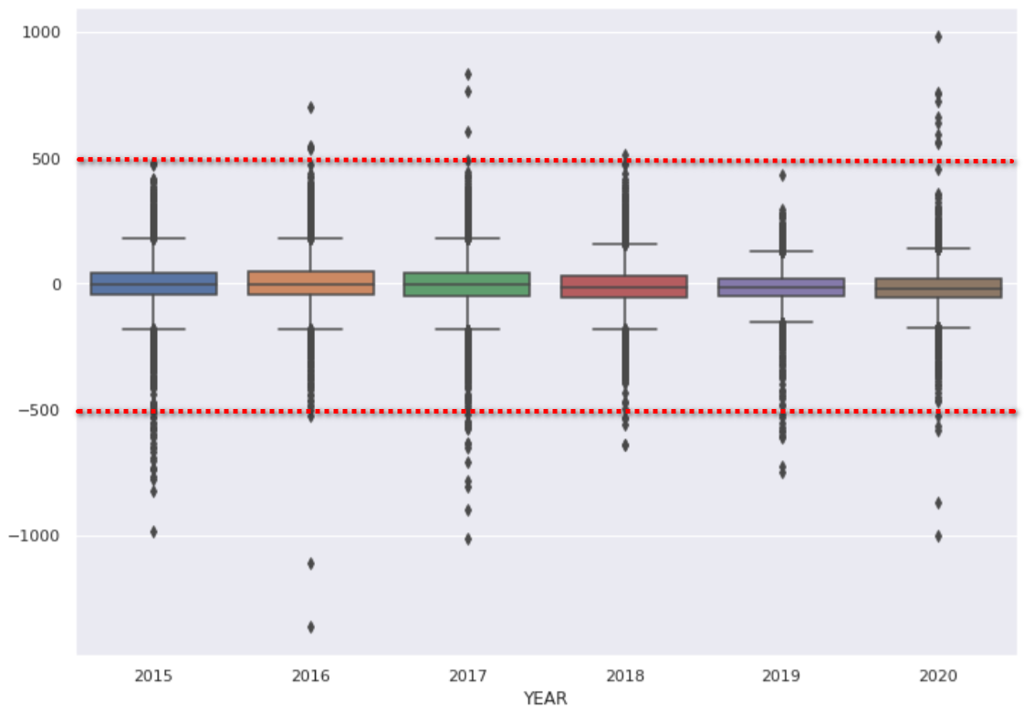
Measure of Success and outlier definition
Difference between Total Demand and Forecast demand year on year for the AEMO model
Notes:
The measure of Success:
· The constraint of our model - Our model is designed to predict the total demand in the near future as the majority of energy supplier can respond to energy demand within 5 minutes. This means the temperature and PV forecast data need to be accurate for this timeframe
· To able to pick up outliers quickly we chose RMSE (Root Mean Square Error) as a measure of success.
· The graph is showing the difference between total demand and forecast demand, the outliers kick in at around + or – 500
· Our business goal was to improve overall accuracy as well as the accuracy of the outliers

Slide 10
74.15
714.42
The RMSE of the AEMO’s forecasted demand to true total demand in 2020
The RMSE of the AEMO’s forecasted demand to true total demand for outliers
Notes:
· We considered to train our models by using 2018-19 data and to test the performance with 2020 data
· The RMSE of AEMO for 2020 is 74.15 and for all the outliers that met our criteria of greater than 500 is 714.42. This is our baseline to measure success

Slide 11
OUR GOAL
BELOW EXPECTATIONS
MEET EXPECTATIONS
EXCEED EXPECTATIONS
Higher RMSE
Similar RMSE
Lower RMSE
Our model has a higher RMSE to that used by the AEMO
Our model produces an RMSE 0%-5% less than the AEMO
Our model produces an RMSE 5%+ less than the AEMO
Notes:
Our Goal:
Any improvement in accuracy will give the energy suppliers more time to respond. That means even small improvements can make a large impact on the energy suppliers, this is particularly significant for the outliers.
Outlier events are the ones that pose the greatest risk to the industry, so any improvement has significant positive outcome for the energy suppliers. For this reason, we have targeted RMSE change of 5% as the improvement standard that we would like to hit.
We intended on comparing multiple models which also give us opportunities to improve the accuracy and precision of the model, as we continue to work with AEMO in the future.
Nee will now take you through the models, and how they performed against these technical challenges and the measures of success that we defined.

Slide 12
02
Journey & Discovery
Notes:
Thanks Ruhul, that was great, now I want to talk through the journey and discovery of the models that we have used.

Slide 13
OUR JOURNEY
DATA GATHERING
MODEL BUILDING
STEP 02
STEP 04
STEP 01
STEP 03
DATA PREP
COMPARISON
Collect and join data from different sources
Run different models and document performance
Clean and transform data
Weighing up pros & cons of different models and RMSEP
Notes:
Key to solving the business challenges was making sure we had the correct information, we had the correct preparation of the data, so that the information fed into our models would be significant, and informative.
Finally we would use consistent measures of success to compare the models against each other, as well as against the the AEMO one..

Slide 14

ADDITIONAL FEATURES
External Data
Feature Engineering
Temp
Time Transformations
AEMO Forecast
Model Inputs
PV
Temp Grouping
Public Holiday
Season Grouping
Notes:
As we have discussed earlier, we have chosen to use the PV data as the additional dataset, temperature and public holiday data is already used by the AEMO.
By re-adding the categorisations of temperature and the public holiday, we were able to provide additional level of details and features engineered into the final models.
These where things such as 5 categories of temperature, treating every 30 minutes as its own category, the seasons that were involved, and each individual day as a category, rather than “working day and non-working day that AEMO used.
For the PV data, we included the estimate of the total MW output that would be generated, and this has been included to show the increase in PV for roof top solar over time.

Slide 15

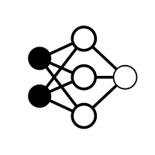
OUR MODELS
TIME SERIES
MULTI-LAYER PERCEPTRON
XGBOOST
LSTM
Baseline Model
Neural Network
Supervised Machine Learning Classification
Recurrent Neural Network
Notes:
WE have chosen 4 models as potential candidates, Time Series, XGBoost, MLP Regressor, and an LSTM.
WE chose Time series because it is the most common, and is only influenced by the single variable, this means it is a model that is sensitive only to the previous values, which can provide greater accuracy when non colinear events occur
We chose the MLP as it acts as a sliding window across the data, and the regression ensures that some of the longer time frame features are established
We chose the XGBoost, its has similar value to the MLP, but boosts the gradient through self correction resulting in faster identification of significant features and more accurate models.
We chose the LSTM as its use of forget gates, and dependence on previous values means it can pick up both long and short term trends in the features and the data.

Slide 16
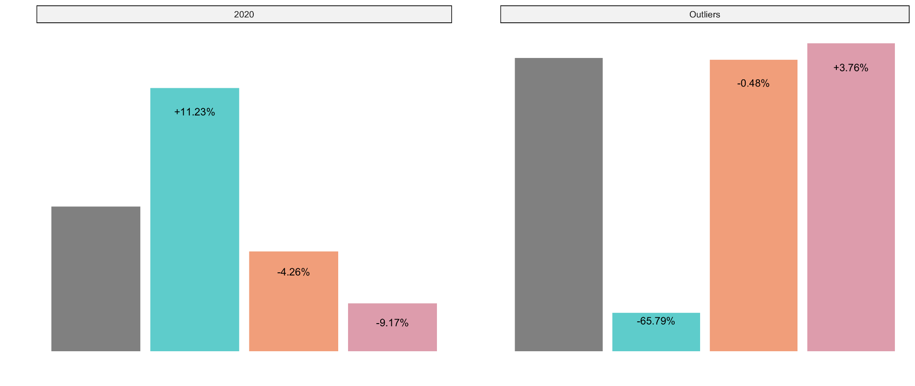
RESULTS
Notes:
After running the different models we came to the following conclusions.
XGB is the best performing model with an RMSE that is 9% less than the target.
LSTM was so bad that we decided not to pursue it further, this is likely as it was so naive it resulted in poor performance, this model we would consider if we added additional data in the future.
Time Series was the best performing for the outliers with an RMSE that is 65% better than the AEMO model. THis is because it accounts for recent values. * edit in
The poor performance of the XBG & MLP shows us that outliers cannot be predicted with the external data sources that we have chosen.

Slide 17
PERFORMANCE AGAINST GOALS
BELOW EXPECTATIONS
MEET EXPECTATIONS
EXCEED EXPECTATIONS
Higher RMSE
Similar RMSE
Lower RMSE
LSTM
MULTI-LAYER PERCEPTRON
TIME SERIES (outliers)
XGBOOST (overall)
Notes:
The final 2 models that gave us the best result are TIme series for outliers, and XGboost for the normal accuracy.
I will now hand over to Peter, who will explain how our capability can be best utiliized. And how it can add value to AEMO

Slide 18
03
Capability & Improvements
Notes:
Thank you Nee. I will now show how the capabilities we have identified in the prior section, can now be utilised by the AEMO to add value to their forecasting process.

Slide 19
Capability
Our model would perform best as a hybrid model, where both the Time Series and the XGBoost always being used.
If on measuring the forecast has moved away from the XGBoost model then the recommendation is to move to the Time series for several hours until the system returns to normal.
This takes advantage of both systems.
Notes:
As Nee has shown, the Time Series model provides the greatest predictive power when outlier event occurs, and the XGBoost provides the greatest predictive power during normal operations. Due to this reason, we are proposing a hybrid model that can takes advantage of both methodologies. The Time Series would be used to predict the outlier events, whilst the XGboost would predict normal days.
The challenge however, is to make sure that we detect the correct trigger point that would switch between the two models. Whilst we have not had sufficient time to model this hybrid system accurately, we are proposing a method that will be achievable, and would be a part of the continued work that we do with the AEMO. As an initial approximation, our current belief is that after an outlier event, the system would head towards a more normal mode of operations after a duration of 2 hours.
One of the things that we have noted in our modeling is that the growth rate of PV usage is exponential, meaning that it will likely result in future models using this feature in order to gain higher accuracy scores. We believe that the capability we have described should be reassessed over the next 6-12 months, to ensure that other events have not started to influence the predictions.

Slide 20




Capability
Temp
AEMO Forecast
PV
XGBoost
Public Holiday
Predicted Total Demand
Total Demand (past observed data)
Time Series
Notes:
Moving onto a visual of our proposed hybrid model, the model we have built is designed for short-term forecasts and uses the current AEMO modeling methods as an input, resulting in re-predictions of data on a regular basis.
Whilst we predict 24 hours in the future, we are aware that the value to the business is only in the first 6 hours in this prediction period. With our proposed Hybrid model, we given the chance to detect when forecasted demand is trending away from the total demand, relatively early on. When the forecast is trending higher above a certain threshold, we are able to trigger the Hybrid Model to switch to the Time Series method. And as a general rule, we estimate that an outlier event lasts for about 2 hours, so after that amount of time has passed, the Hybrid Model would move back to to XGBoost method.
As both models are always predicting outcomes, we believe that this Hybrid approach would not only produce continuously accurate results, but would also be resilient to unexpected events, as it has the ability to auto-adjust to the current environment.

Slide 21


Implementation
Currently AEMO is already receiving the Temperature, Public Holiday data.
We use more granular binning of data such as date, time, temperature to build a more robust model.
We need to provide Solar PV sample data for forecasting events. This can be done either theoretically, or by modelling of the PV Data and rollout.
Notes:
Since the AEMO is already using temperature & public holiday data, our implementation would not require that many changes to the datasets that are currently utilised.
However, we do note that the temperature values that we have used are derived from the Bankstown Airport area, and this was used a proxy for the temperature of the entire NSW region. This is a reasonable assumption as the temperature across the NSW region is fairly consist, and in particular it is consistent with the energy demand in high-density areas of NSW. Since energy demand is roughly proportional to population size, and since the majority of people are located in the Sydney basin, we believe that the temperature data from the Bankstown Airport area is appropriate.
We also note an assumption regarding PV data. The data was sourced from an external site and then normalised & scaled to the size of PV installations across NSW. Because PV data is dependent on the amount of radiation hitting the surface of the panel, it has a greater variance than temperature. To make sure that the PV data was representative of the population, we took the data from 3 different locations and did a spot-comparison on several days, and we determined that we should be using PV data from the Canterbury district for modeling purposes.
So with that, I will now hand it back over to James to wrap up.

Slide 22

Want more information?
https://github.com/Jimbobaus/project---What-Watts---Group-A
Thank you for listening
What Watts Consulting
Notes:
Thank you for the opportunity of explaining our capability to you, as you can see the hybrid model we are proposing gives the best of both worlds, it provides the accuracy for the high risk outlier events, and it provides stability and accuracy for normal day to day operations. IF you want to see any of the finer details of hte modeling we have done What Watt Consulting has made the models we have done available through our source controlled git hub.
We look forward to expanding the capability we have developed with you to provide even greater accuracy and precision into the future.

